Slide 1

🎖️ Welcome Space Cadets! This is the Agentic AI Hackathon 2125

Slide 2


Fundamental Shift in AI is underway
AI that can generate for you
AI that can chat for you
AI that can do for you
Models
Assistants
Agents
​Next Token Prediction
Text Generation
Pattern matching
Information retrieval​
Prescriptive tasks​
Single-step processes​
Multi-step processes​
Autonomous action-taking​
Self-correcting​
Input
Input
Agent
Action
Plan
Agent
Action
Action
Action
Agent
Input
Reflect
Agent
© 2025 cloudflight / IBM Corporation
Action
Traditional assistants
Single-agent assistants
Multi-agents assistants
Notes:
1/3 of gen AI interactions will use action models and autonomous agents by 2028
Gartner Predicts One-Third of Interactiosn with GenAI Services Will Use Action Models & Autonomous Agents for Task Completion by 2028, 11 March2024. GARTNER is a registered trademark and service mark of Gartner, Inc. and/or its affiliates in the U.S. and internationally and is used herein with permission. All rights reserved.

Slide 3


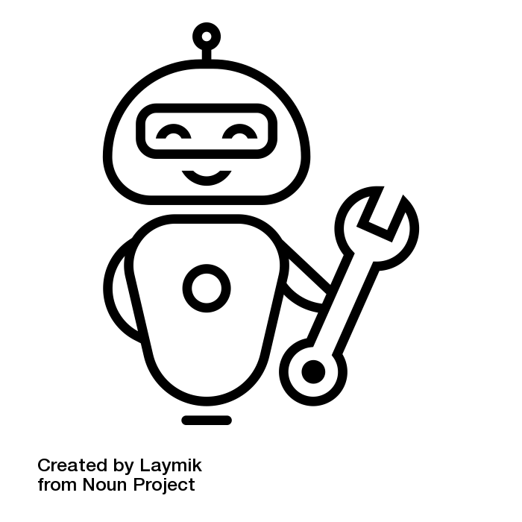

Transitioning to an Agentic future
LLM Chatbot
LLM Agents
Multi Agent orchestration
“Write a storyline for a keynote on AI in insurance”
“Compare our earnings with competitors and summarize in an email”
“Evaluate attached claims documents, assess coverage & costs and suggest repair”
generic GenAI LLM
Plan / Execute / Reflect
Plan / Execute / Reflect
LLM Agent
LLM Agent 1 [Claims Handler]
1
Tool A (eg. finance database)
optional: based on set of documents or knowledge database
2
Knowledge search
LLM Agent 4 [Repair Search]
3
Tool B (eg. CRM system)
LLM Agent 2 [Policy Evaluator]
4
Self reflect, Human feedback
LLM Agent 3 [Cost Estimate]
© 2025 cloudflight / IBM Corporation

Slide 4
Agentic AI closes the gap between chat bots and humans ¹
Mind the AI Agency Gap
Deterministic Chatbots
LLM-based Assistants
Human Agency
Low Agency
High Agency
AI Agency Gap
Static
Adaptive
Reactive
Proactive planning
Simple Tasks
Complex Goals
Simple Environment
Complex Environment
Supervised
Autonomous
¹ Gartner Top Strategic Technology Trends for 2025: Agentic AI
Notes:
“We’ve had agents for as long as we’ve had AI. What’s new is that agentic AI is now commonly defined by its dependence on generative AI. The buzz of agentic AI stems from its potential to extend the emergent, probabilistic abilities of large language models (LLMs) to new action spaces. While generative AI creates answers or content, agentic AI can autonomously act upon those answers.
Full 1st quote: “Agentic AI refers to goal-driven software entities that have been granted rights by the organization to act on its behalf to autonomously make decisions and take action. These entities use AI techniques — combined with components such as memory, planning, sensing, tooling and guardrails — to complete tasks and achieve objectives. “

Slide 5
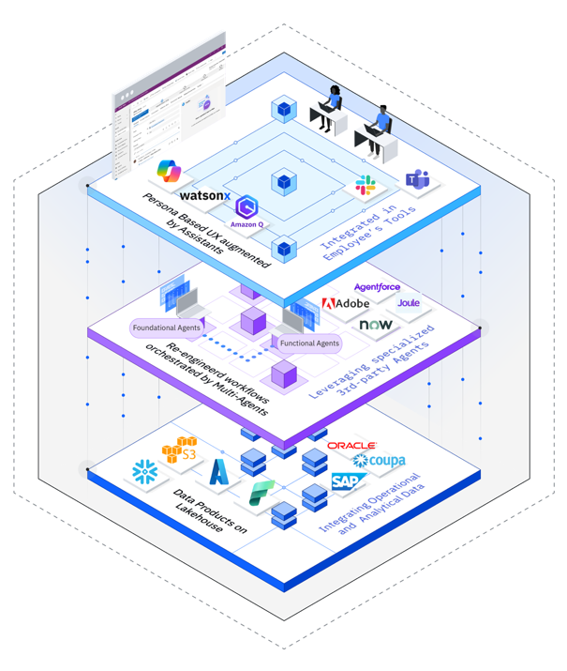
Agentic apps require readiness across the entire tech stack
Has a new UI for AI
5
A new Persona based User Experience augmented by Assistants delivering end to end User Journeys …
Is augmented by Agentic Workflows
… that are orchestrated and automated through a set of autonomous AI Agents that completely transform the existing workflows …
Is grounded on Data Products
... enabled by specific Data Products delivering high quality operational and analytical insights

Slide 6
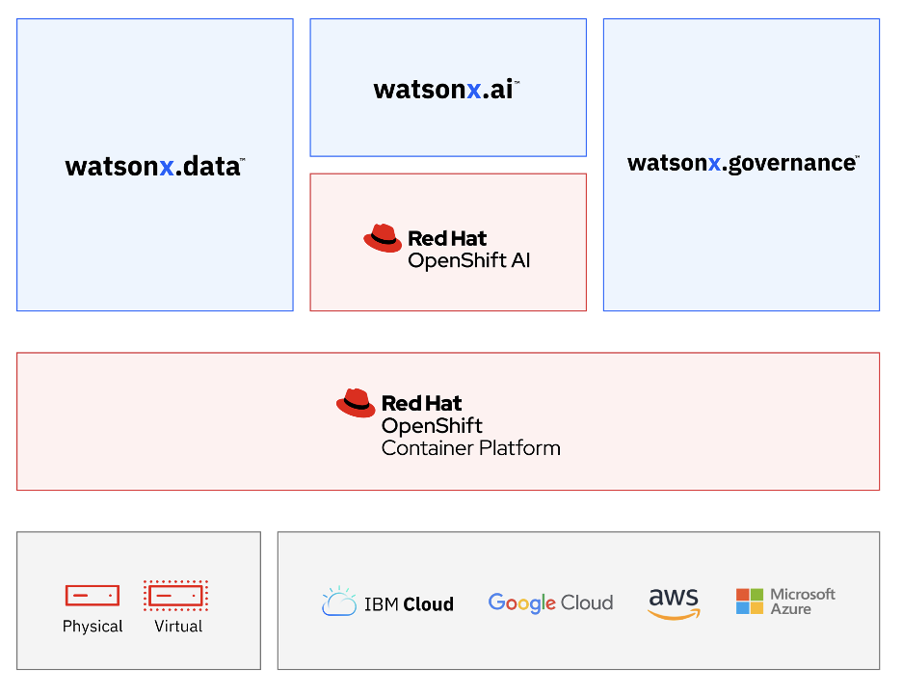
Ihre Anforderungen im Fokus Nutzen Sie eine Plattform, die sich an Ihre Ziele anpasst
Open Eine offene Plattform, die auf Open Source-Innovationskraft setzt und bereits getätigte Investitionen schützt
Own (Targeted) Wählen Sie aus unterschiedlichen Modellen und bleiben Sie flexibel wenn sich Anforderungen ändern (Eigene, Partner, IBM, Open Source)
On premise (Trusted) Setzen Sie souveräne KI um, wo und wie immer sie wollen (lokales RZ, in-a-box, jede Cloud)
Empowering Skalieren Sie mit einer Ende-zu-Ende KI-Plattform inklusive Daten- und KI- Governance und bleiben Sie Wechselfähig mit RedHat OpenShift
Einfaches trainieren, validieren und optimieren von KI-Modellen & maßgeschneiderten AI Agents
watsonx
watsonx Orchestrate
watsonx Discovery
Data store nach Maß - basierend auf einer offenen Lakehouse-Architektur mit Abfragefunktionen, Governance und offenen Formaten für Datenzugriff und -austausch
Gewährleisten Sie verantwortungsvolle und transparente Daten- und KI-Workflows & behalten Sie Modelle, Qualität und Warnhinweise im Blick
Konsistentes Hybrid-Cloud-Fundament zum Erstellen und Skalieren containerisierter Apps.
Volle Souveränität durch Installation der gesamten Plattform auf einem Server – offene, vorintegrierte KI-Plattform „in-a-box“.
...und sichern Sie sich das Beste aus beiden Welten – die Sicherheit von on‑prem und die Flexibilität der (privaten) Cloud
Implementieren Sie nach Ihren Vorstellungen...
© 2025 cloudflight / IBM Corporation
6

Slide 7

















AI Agents & Assistants, AI Agents
Overview
Benefits
Multi-agent orchestration
To drive productivity, enterprises will need multiple agents across domains to execute their complex use cases.
IBM offers a multi-agent, multi-tool supervisor, router, and planner to facilitate complex task execution across your agent landscape.
LLM-powered routing to the most relevant agents, assistants, and skills to resolve the task at hand
Easy to scale & adjust, accelerating time to value each time you add new functionality as your enterprise requirements and tech stack evolves
Embed anywhere for enhanced collaboration and user experience
Multi-agent Orchestration
Collaborator Agents & Tools
Client Layer
Orchestrator Agent
Domain Agent
Agents
APIs & Apps
Ariba
HR, Procurement, Sales, etc.
End User
Agent 1
Tool Catalog (Discovery and Binding)
Actions and Dialog Flows
Knowledge (Documents)
wxO Agent Builder & SDK
BYOA
Business Automation Flows
Pro-Code Tools
Data Sources (SQL, etc.)
Built-In Tools (Web search, …)
3rd-Party Agents
Data Sources (SQL, etc.)
Built-In Tools (Web search, …)
7

Slide 8
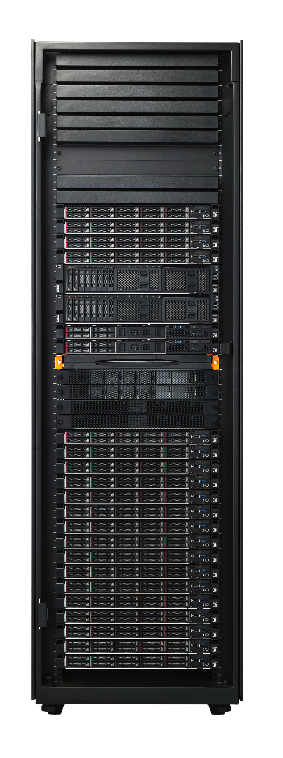
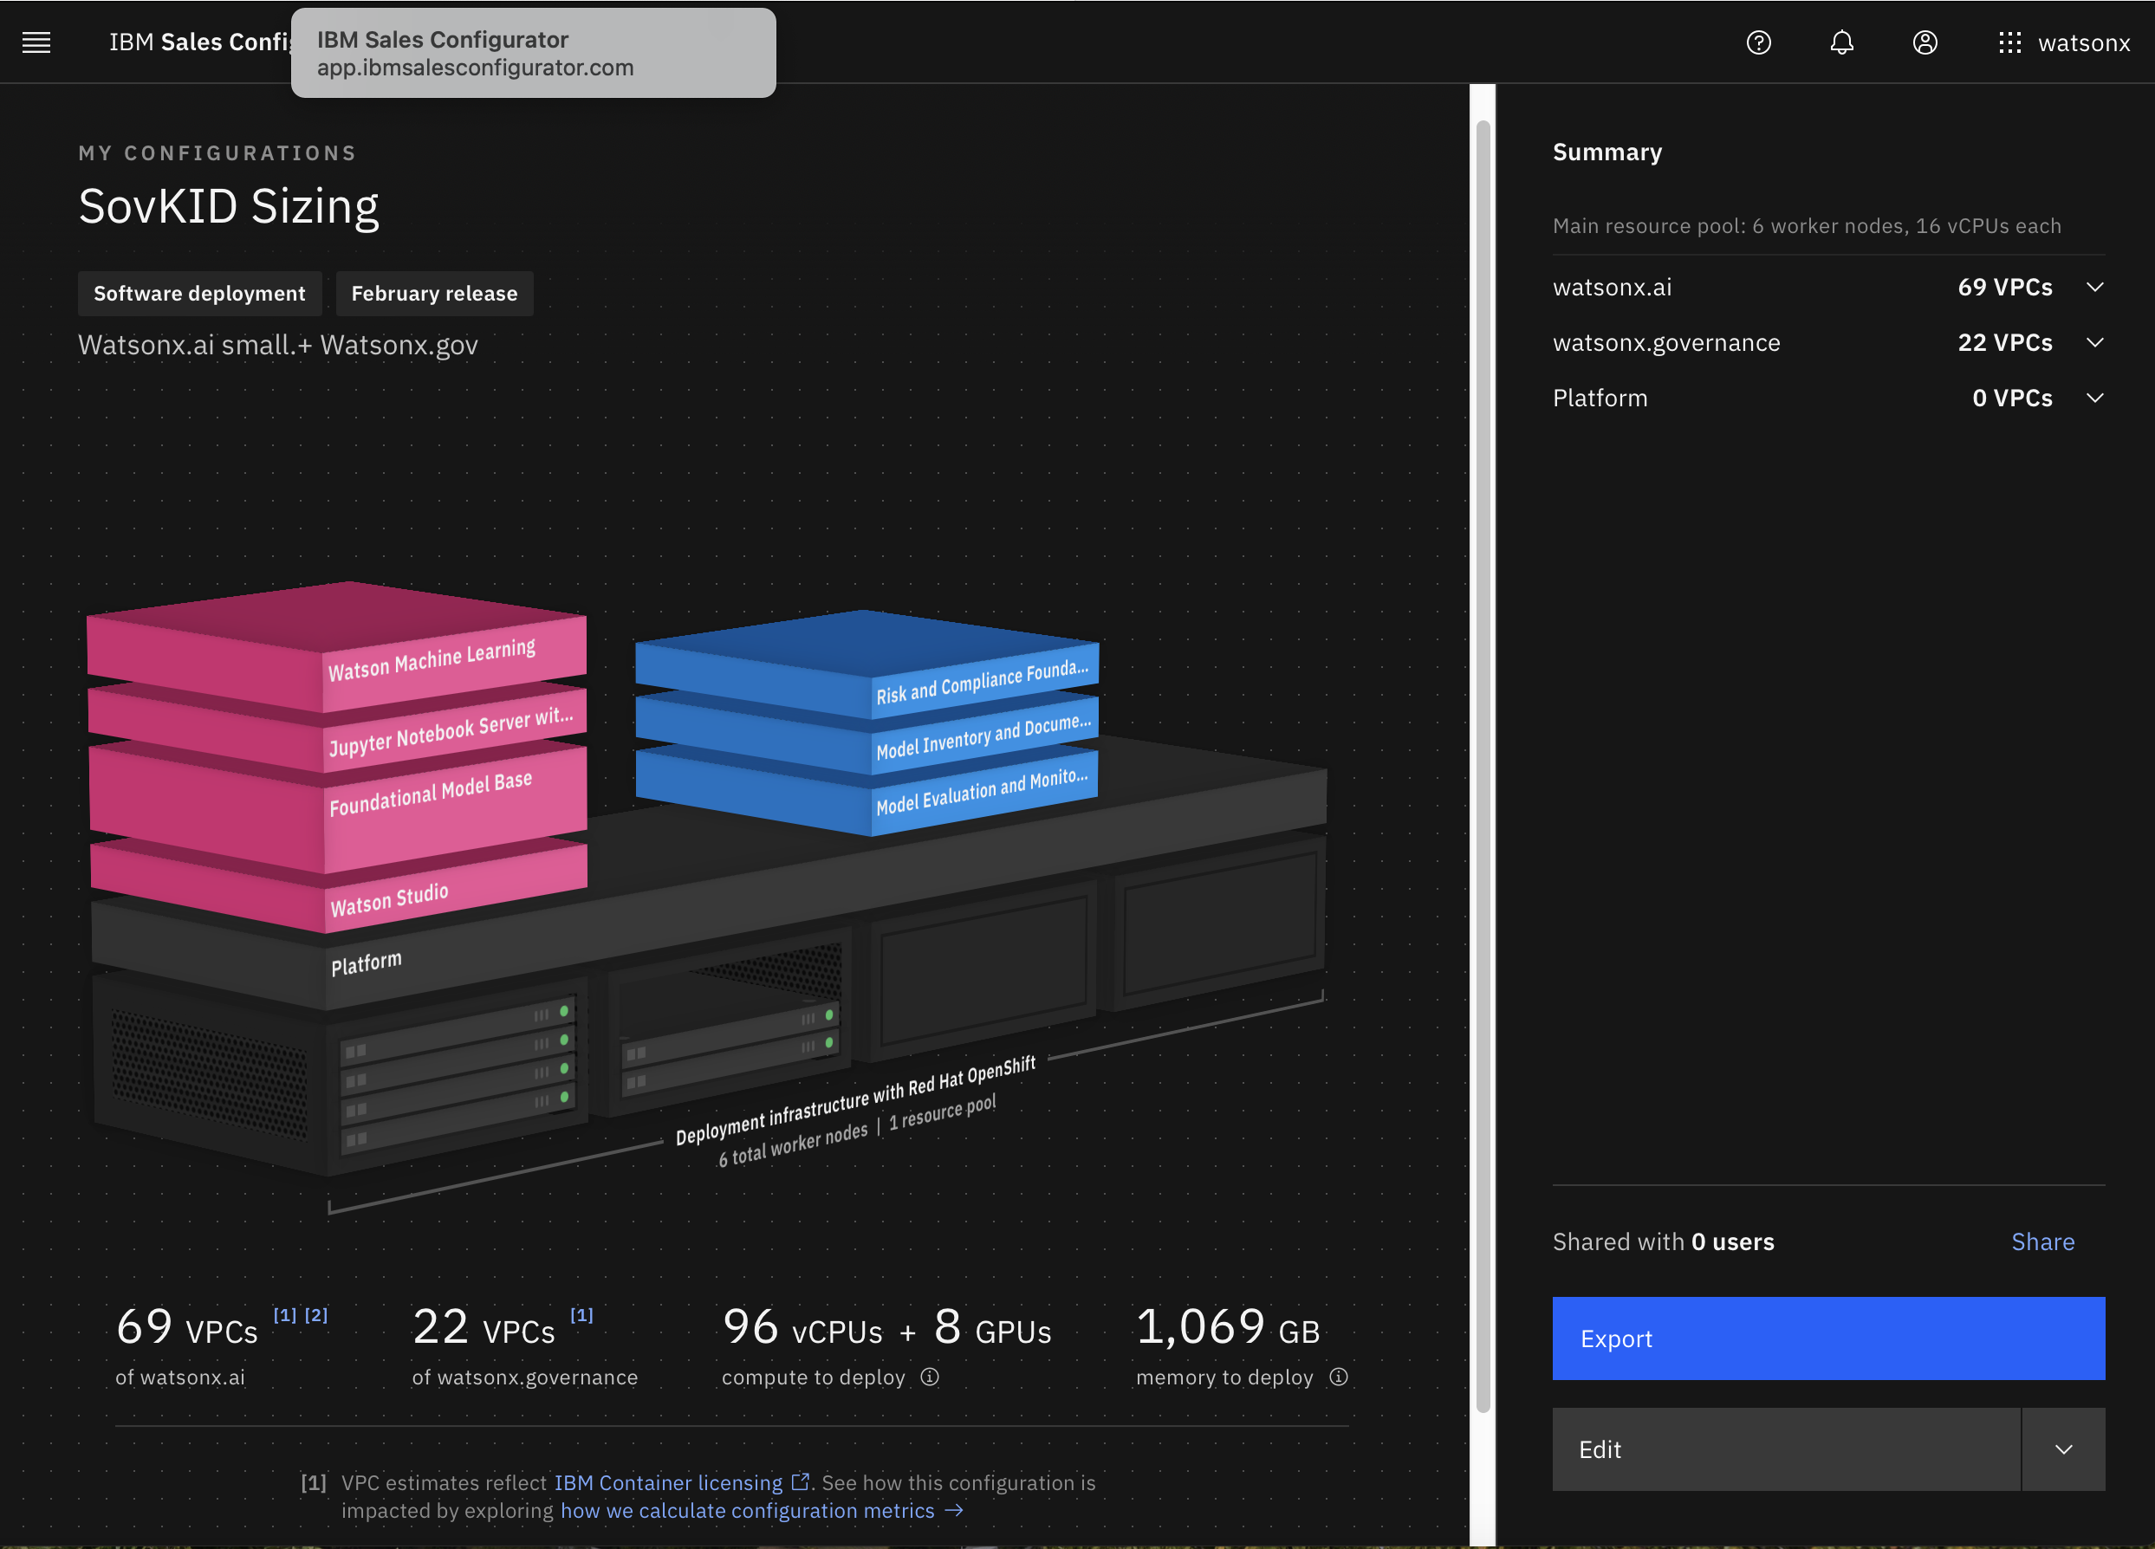
Für die Umsetzung der souveränen KI gibt es verschiedene Alternativen, wo der Software Technologie-Stack betrieben werden kann
Software Technologie Stack
1
(on-prem)
Im eigenen Rechenzentrum auf eigener Hardware durch eigene
IT oder durch Business Partner betrieben
2
(in-a-Box)
Appliance basierend auf x86 Hardware für Virtualisierung & Containerisierung als Grundlage von OpenShift für watsonx und Cloud Pak for Data (optional)
Nodes mit Nvidia und AMD GPUs lieferbar
3
(Partner-RZ/Cloud)
In jedem Partner - oder Cloud- Rechenzentrum (RZ) betrieben durch Partner
IBM Fusion HCI
8

Slide 9

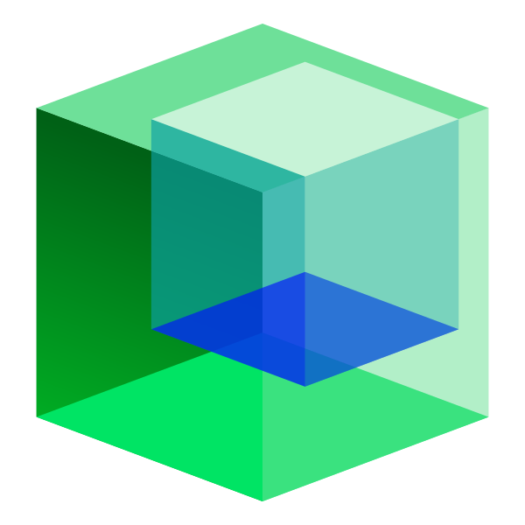










AgentOps
AI/ML Ops, AI Tools
Overview
Benefits
AgentOps enables end-to-end agent lifecycle management & brings together the models, tools, frameworks, & evaluation metrics into a unified process.
The simplified stack enables development lifecycle optimization and enhances performance and cost efficiency
Lifecycle observability enabling visibility & tracking into custom agent lifecycles
Simplified agent deployment with one-click deployment
Build custom agents with all the models, tools, frameworks & evaluation metrics needed to optimize agents
18hrs of development time saved
Agent Creation
Agent Management
Build
Run
Manage
Model Support
Tool Support
Customization
Agent Creation
Templates
Agent onboarding and verification
Deployment
Monitoring and alerts
Auditability
Optimizations
Model
Support
Model Customization
Agent Frameworks
Tool Support
Deployment Choices
Tracing Coming soon
+ Custom model import
1000+ SOTA models
Prompt engineering
Prompt tuning
Full fine-tuning
PEFT
InstructLab
Enabling Python based frameworks
Pre-built, 3rd-party custom tools
Model context protocol (MCP)
1500+ prebuilt skills in watsonx Orchestrate
Deploy to customize in the IDE of choice, or watsonx Orchestrate, use in production
Link to blog >>
© 2025 cloudflight / IBM Corporation
9

Slide 10

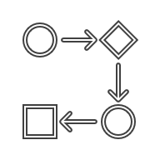



What IBM offers
watsonx.governance
Trusted: Enable responsible, transparent and explainable AI workflows
A toolkit for AI governance
Govern any model across the entire AI lifecycle by consolidating multiple tools, applications and platforms while documenting the origin of data sets, models meta data and pipelines
Manage risk and protect reputation by automating workflows to better detect fairness, bias and drift
Adhere to internal compliance standards
Model inventory
(capture model facts throughout the lifecycle)
Model risk governance
(workflows, dashboards, incident management)
Sync model status and metadata
Capture deployment meta-data
Capture training meta-data
Build
(IBM, AWS, MS, Other)
Deploy
(IBM, AWS, MS, Other)
Deploy approved model
Capture model performance meta-data
Pre-deployment model evaluation
Evaluation and monitoring
(accuracy, drift, bias, explainability)
Post-deployment model monitoring
10
Notes:
Watsonx.ai is part of the IBM watsonx platform that provides foundation models and generative AI capabilities, plus traditional AI modelling that clients have come to know (in IBM Watson Studio and IBM Watson Machine Learning).
There are three main components in watsonx.ai:
Foundation model libraries – these include many well-known models such as Codex, Generative Pre-trained transformer (GPT), Fine-tuned Language Net (FLAN), and more, as well as IBM’s own foundation models.
Prompt lab – Prompt engineering is a way of helping the model to be more accurate and precise in its response by providing some user input (called prompts). Prompt engineering is an art and requires practice. IBM provides samples of prompts, and the studio helps users to try different prompts and different models to get the best results.
Tuning studio – there are multiple ways that watsonx.ai lets clients fine-tune the foundation models:
Changing various parameters (example)
Providing additional data to further train the model
However, it is important to remind clients that the base AI capabilities (Watson Studio, Watson Machine Learning, etc.) are still there for the clients and clients will continue to enjoy existing capabilities such as:
Model operations: training, deploying, managing, etc.
Automated development
Team collaboration
Decision optimization
Notes:
When using watsonx, maintain coloring and bolding whenever possible.
An algorithm is a procedure used for solving a problem or performing a computation. Algorithms act as an exact list of instructions that conduct a sequence of specified actions in either hardware- or software-based routines.
Foundation models are typically built using a specific kind of neural network architecture, called a transformer, which is designed to generate sequences of related data elements (for example, a sentence).
Generative AI refers to a set of AI algorithms that can generate new outputs — such as text, images, code, or audio — based on the training data, unlike traditional AI systems that are designed to recognize patterns and make predictions. Sometimes the AI that powers these solutions are referred to as decoders.
A large language model (LLM) is a type of machine learning model that has been trained on large quantities of unlabeled text using self-supervised learning and can perform a variety of natural language processing (NLP) tasks (even when that language is a programming language). Output may range from books, articles, social media posts, online conversations, and even code. The architecture of an LLM consists of layers of neural networks that learn to generate language in a way that is similar to how humans use language.
Machine learning (ML) refers to a broad set of techniques to train a computer to learn from its inputs, using existing data, and one or more “training” methods, instead of being explicitly programmed. ML helps a computer to achieve AI.
Natural language processing (NLP) is the technology that gives computers the ability to understand text and spoken words in much the same way human beings can. NLP combines computational linguistics — rule-based modeling of human language — with statistical, machine learning, and deep learning models. These technologies enable computers to process human language in the form of text or voice data and to ‘understand’ its full meaning, complete with the speaker or writer’s intent and sentiment.
Neural networks are a set of algorithms, modelled loosely after the neural networks found in the human brain, that are designed to recognize hidden patterns in data.
A transformer model is a neural network architecture useful for understanding language, which does not have to understand words one at a time but can look at an entire sentence at once for context and disambiguation. A technique called self-attention allows these models to focus on the particular words that are important in understanding the meaning of the sentence. Transformers single-handedly spawned the world of foundation models and its birthplace research paper (Attention is all You Need) spawned the AI inflection point that is happening today. AI transformer models can be Encoder models (like BERT), Decoder models (like GPT), or Encoder and Decoder models (like T5). Learn more about Transformers at: https://www.youtube.com/watch?v=ZXiruGOCn9s.
Parameters are numerical values that define a large language models (LLM’s) structure and behavior, like clues that help it guess what words come next. Modern systems like ChatGPT are thought to have hundreds of billions of parameters.
GPT stands for Generative Pre-trained Transformer and refers to a family of neural network-based large language models (LLMs) developed by OpenAI; for example, GPT-3 and GPT-4.

Slide 11
🎖️ Welcome Space Cadets! The story begins ..

Slide 12


👾Story
The year is 2125 (...)
Today marks the end of “their” plans. Today, we will no longer retreat! Today, we take back what is ours!

Slide 13

🤔Situation
On behalf of all people, we are to fight humanity's "last battle"!
“They” destroyed our default communication channels.
But there is watsonx, a 2025 good old earth age software.

Slide 14

👽 Problem
We are under attack!
We need to create battle plans, now!
All you need, is in the repository.
The survival of humanity depends on you.
Good luck, Space Cadets!
https://github.com/cloudflightio/agentic-ai-hackathon-2125

Slide 15
👽 Problem
We are under attack!
We need to create battle plans, now!
All you need, is in the repository.
The survival of humanity depends on you.
Good luck, Space Cadets!
https://github.com/cloudflightio/agentic-ai-hackathon-2125

Slide 16
📖 Rules
You will compete in several missions.
After each mission, call a Space Instructor to get your solution verified.
You will be rated with Space Points.
There is no exact solution on how to solve the missions.
Creativity wins.
Good luck, Space Cadets!
https://github.com/cloudflightio/agentic-ai-hackathon-2125

Slide 17

👽 Mothership spotted
ALARM! "Their" mothership has been spotted. This is our chance to strike back!
The survival of humanity depends on you.
Good luck, Commander!

Slide 18
👽 Mothership spotted
ALARM! "Their" mothership has been spotted. This is our chance to strike back!
The survival of humanity depends on you.
Good luck, Commander!

